Slide 1


Department of Artificial Intelligence and Data Science
CITIZEN FEEDBACK POLICY SENTIMENT
SABHARISHRAJA B(231801143) DARSHAN R(231801133)
SABARISH P(231801142)
Mrs.K.SELVARANI

Slide 2
Introduction
The Citizen Feedback Policy Sentiment Analysis project uses Big Data technologies to analyze public opinions on government policies. Large volumes of citizen feedback are processed using Apache Spark for distributed data handling and TextBlob for sentiment classification. The pipeline includes data ingestion, cleaning, analysis, and visualization to identify positive, negative, and neutral sentiments. This helps policymakers make data-driven decisions and improve governance effectively.

Slide 3
Abstract
The Citizen Feedback Policy Sentiment Analysis project applies Big Data analytics to evaluate public opinions on various government policies. Large volumes of citizen feedback are collected, cleaned, and processed through a data pipeline using Apache Spark for distributed computation. TextBlob is used for sentiment classification to identify positive, negative, and neutral opinions. The analyzed insights are visualized through dashboards, enabling policymakers to make informed, data-driven decisions and enhance public service delivery.

Slide 4
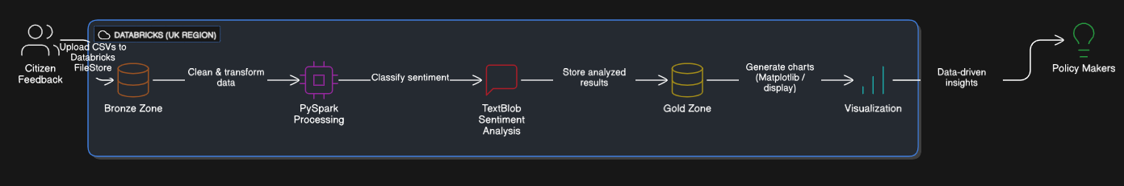
Architecture

Slide 5
Modules Overview
Data Ingestion Module: Uploaded and imported citizen feedback CSV data into Databricks FileStore for analysis.
Data Storage Module: Managed data within Databricks workspace using structured storage zones (Bronze, Silver, Gold) to organize raw, cleaned, and analyzed data.
Data Processing Module: Utilized Apache Spark (PySpark) within Databricks notebooks to clean and transform feedback data efficiently.
Sentiment Analysis Module: Applied TextBlob in Databricks to perform sentiment classification as Positive, Negative, or Neutral.
Visualization Module: Used Databricks’ built-in display() functions and matplotlib for visualizing sentiment distribution across policies.

Slide 6


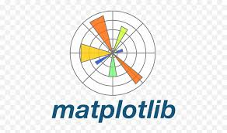


Tools Used
PySpark: Used for distributed data processing, cleaning, and transformation within Databricks notebooks.
Python: Utilized for scripting, sentiment analysis using TextBlob, and data visualization.
Databricks: Served as the integrated platform for code development, execution, and managing the complete Big Data workflow.
TextBlob: Applied for Natural Language Processing (NLP) to classify citizen feedback into positive, negative, or neutral sentiments.
Matplotlib: Used to visualize sentiment analysis results and trends through bar charts.

Slide 7
Implementation
Data Ingestion: Uploaded citizen feedback CSV file into Databricks FileStore for analysis.
Data Storage: Organized data within structured zones — Bronze (raw), Silver (cleaned), and Gold (sentiment results) — simulating a Big Data pipeline.
Data Processing: Used PySpark in Databricks notebooks to clean, transform, and prepare feedback data for analysis.
Sentiment Analysis: Applied TextBlob for Natural Language Processing (NLP) to classify each feedback as Positive, Negative, or Neutral.
Visualization: Utilized Databricks display() and Matplotlib to visualize sentiment distribution and policy-wise insights through bar charts.

Slide 8
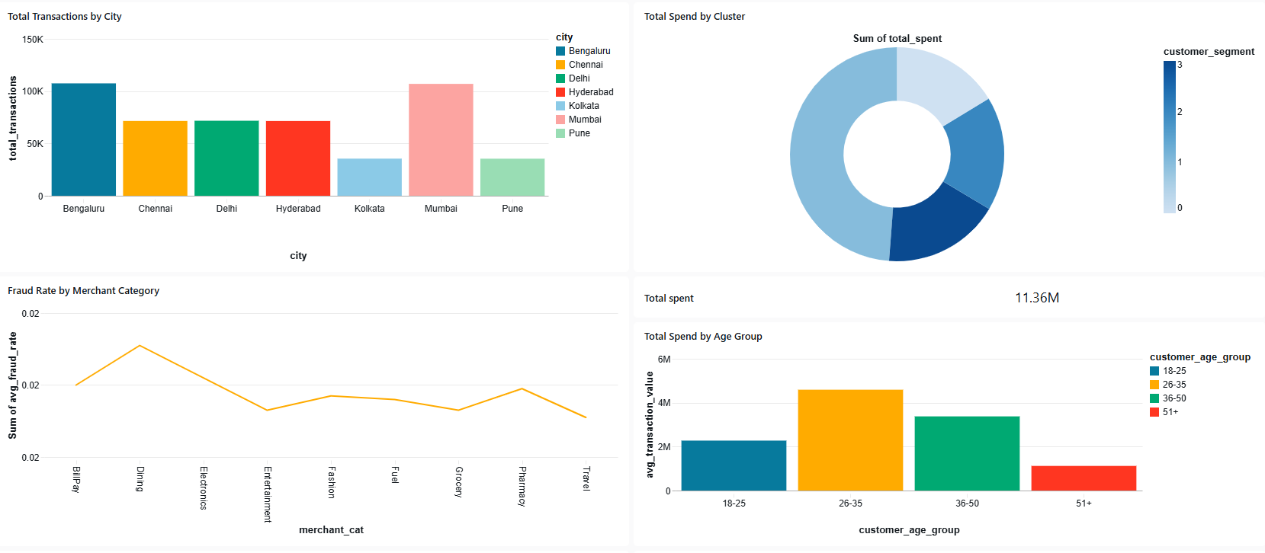
Dashboard Visualization

Slide 9
Results
Classified citizen feedback into three sentiment categories: Positive, Negative, and Neutral using TextBlob in Databricks.
Generated policy-wise sentiment counts using PySpark groupBy() operations.
Visualized sentiment distribution across policies through bar charts using Matplotlib and Databricks’ built-in display() feature.
Identified key insights such as policies with the highest positive sentiment and those with more negative feedback, helping policymakers focus on improvement areas.
Produced a summary dataset (Gold layer) containing analyzed results for further visualization and reporting.

Slide 10
Conclusion & Future Scope
The project successfully implemented a Big Data pipeline using Databricks and PySpark to analyze citizen feedback on government policies.
Feedback data was cleaned, processed, and classified into Positive, Negative, and Neutral sentiments using TextBlob.
The results provided policy-wise insights, helping policymakers identify areas requiring improvement.
Future Scope:
Integrate real-time data ingestion using Apache Kafka for live feedback monitoring.
Enhance accuracy using advanced NLP models such as BERT or VADER.
Develop interactive dashboards using Power BI or Tableau for deeper visualization.
Extend the system to support multilingual sentiment analysis for diverse citizen feedback.

Slide 11
References
Databricks Delta Lake Guide — https://docs.databricks.com/delta/index.html
Apache Spark Documentation — https://spark.apache.org/docs/latest
“Citizen Feedback Policy Sentiment Analysis Using Big Data,” IJCA, 2024
Kimball, R. The Data Warehouse Toolkit, Wiley, 2013
TextBlob Official Documentation — https://textblob.readthedocs.io/en/dev
Databricks Official Documentation — https://docs.databricks.com

Slide 12
Thank You

